Slide 1
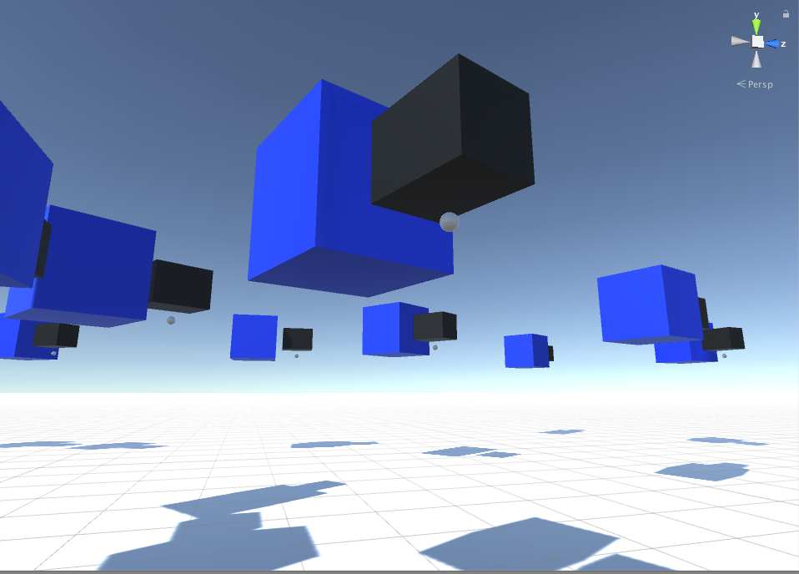
Camott-EcoSim
Stuff has happend in this time!

Slide 2
Refresh
“We want to create a simple ecosystem simulator in which an original set of “creatures” changes and evolves over time.”
“We hope to see behaviours such as preditor-pray relationships emerge over time.”
Creatures should start with a simple body and evolve...

Slide 3
What went wrong
NN: Big and complex.
RNN: Bigger and more complex.
Unity: Has no support for arbitrary matrices,, Libraries are hard, and in general, also, not fun to try and figure out what broke where.
Oh, time, where did it all go?

Slide 4
What we learnt about Neural networks
Computationally expensive: Get a GPU, use it. (Or at-least multithread it)
Good for well-defined behaviours, (I tested it: it can do logic gates.)
Why all the simulations are twitchy: Because neural networks don’t apply well (Atleast at this level of implmentation)
It did kinda-work though! They learn to go forwards and hit stuff to eat it! <Todo: put link here>

Slide 5
BOIDS!
Boids?
Yes Boids

Slide 6
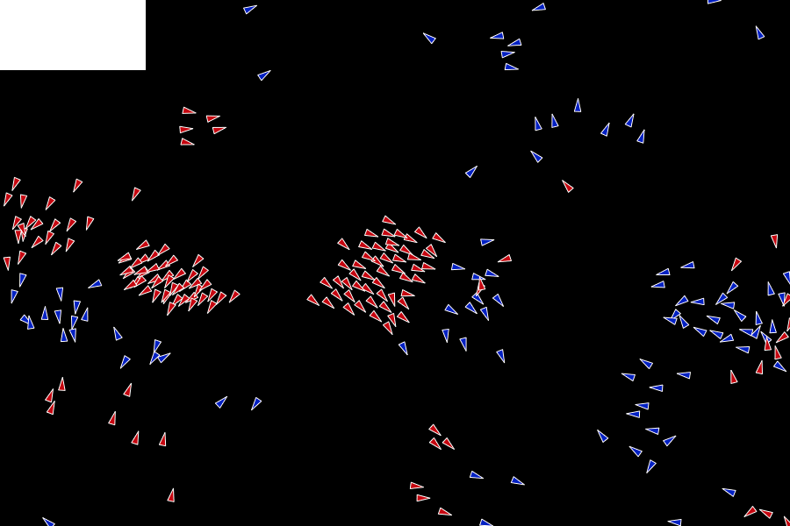
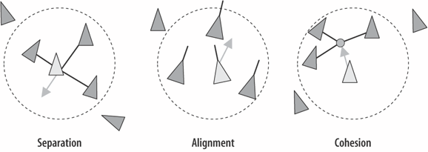
A new hope BOIDS!
    What’s a boid? Can I eat it?

Slide 7
Pseudo Code
PROCEDURE move_all_boids_to_new_positions()
Vector v1, v2, v3
Boid b
FOR EACH BOID b
v1 = rule1(b)
v2 = rule2(b)
v3 = rule3(b)
b.velocity = b.velocity + v1 + v2 + v3
b.position = b.position + b.velocity
END
END PROCEDURE

Slide 8
Separation
PROCEDURE rule2(boid bJ)
Vector c = 0;
FOR EACH BOID b
IF b != bJ THEN
IF |b.position - bJ.position| < 100 THEN
c = c - (b.position - bJ.position)
END IF
END IF
END
RETURN c
END PROCEDURE

Slide 9
Alignment
PROCEDURE rule3(boid bJ)
Vector pvJ
FOR EACH BOID b
IF b != bJ THEN
pvJ = pvJ + b.velocity
END IF
END
pvJ = pvJ / N-1
RETURN (pvJ - bJ.velocity)
END PROCEDURE
Pseudo code taken without minimum modification from:
http://www.kfish.org/boids/pseudocode.html
All credit goes to the original author Conrad Parker.

Slide 10
Cohesion
PROCEDURE rule1(boid bJ)
Vector pcJ
FOR EACH BOID b
IF b != bJ THEN
pcJ = pcJ + b.position
END IF
END
pcJ = pcJ / N-1
RETURN (pcJ - bJ.position)
END PROCEDUR

Slide 11
Our implementation
OpenGL an C++, the much better alternatives to unity
1 main loop to rule them all!
Object representation of flocks and boids
Text file representation for flock coefficients
Source code:
https://github.com/Makogan/emergent2

Slide 12
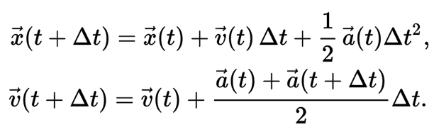
Verlet Integration
Fancy Maths!

Slide 13
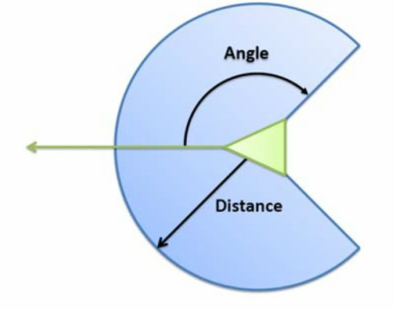
When we put it all together
Click for magic:
https://www.youtube.com/watch?v=t3iOJO58kVQ&feature=youtu.be

Slide 14
The Future!
Object avoidance
Herding the flocks
More flocks!
Bigger flocks!
Better BOIDS! (yes boids)
Predators (maybe a use for our NN)

